Slide 1
Inheritance

Slide 2
Type of association between objects:
IS-A or Kind-of
Also known as Generalization or Specialization
HAS-A or Part-of or contains-of
Also known as Aggregation or Containership

Slide 3
IS-A (Inheritance)
Inheritance represents the IS-A relationship, also known as parent-child relationship.
Inheritance is a mechanism in which one object acquires some of the properties and behaviours of parent object.
The idea behind inheritance is that you can create new classes that are built upon existing classes.
When you inherit from an existing class, you can reuse methods and fields of parent class, and you can add new methods and fields also.

Slide 4
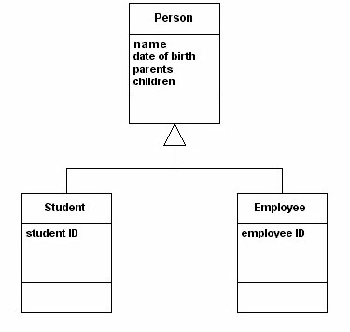
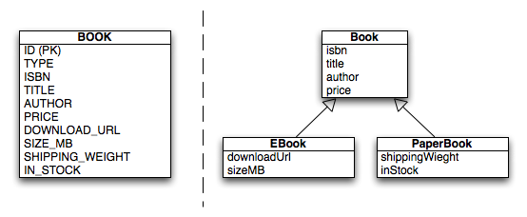
Example: Inheritance

Slide 5
HAS-A (Aggregation)
If a class contains an object of other class, it is known as Aggregation. Aggregation represents HAS-A relationship.
It is a special form of Association where:
It represents Has-A relationship.
It is a unidirectional association i.e. a one way relationship. For example, department can have students but vice versa is not possible and thus unidirectional in nature.
In Aggregation, both the entries can survive individually which means ending one entity will not effect the other entity

Slide 6
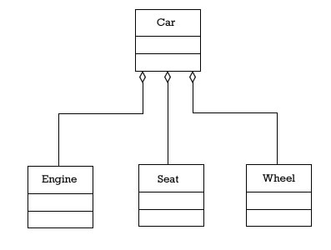
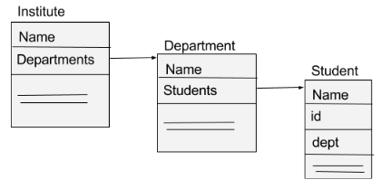
Example: Aggregation

Slide 7
Why Inheritance and Aggregation
Why use inheritance
For Method Overriding (so runtime polymorphism can be achieved).
For Code Reusability.
Reuse is also best achieved by aggregation when there is no is-a relationship.

Slide 8
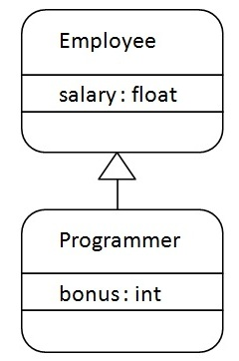
Toy Examples in Java
class Subclass-name extends Superclass-name
{
//methods and fields
}

Slide 9
class Employee{
float salary=40000;
}
class Programmer extends Employee{
int bonus=10000;
public static void main(String args[]){
Programmer p=new Programmer();
System.out.println("Programmer salary is:"+p.salary);
System.out.println("Bonus of Programmer is:"+p.bonus);
}
}
Output:
Programmer salary is:40000.0
Bonus of programmer is:10000

Slide 10
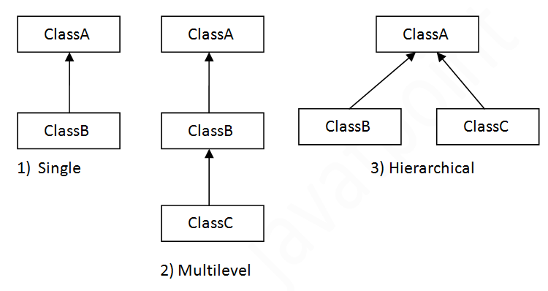
Types of Inheritance

Slide 11
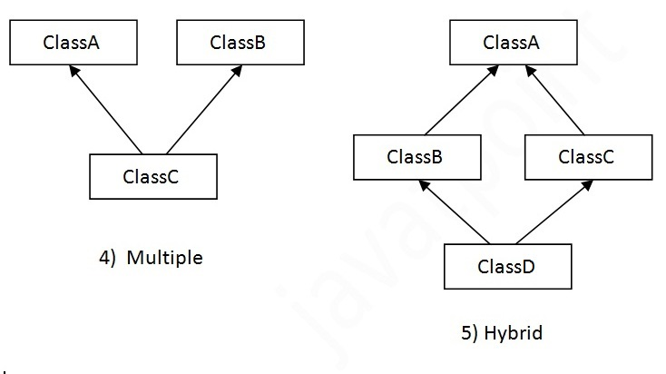
Types of Inheritance…Contd

Slide 12
Single Inheritance Example
class Animal
{ void eat()
{
System.out.println("eating...");
}
}
class Dog extends Animal
{
void bark(){System.out.println("barking..."); //eat(); }
}
class TestInheritance
{
public static void main(String args[])
{
Dog d=new Dog();
d.bark();
d.eat();
}
}
Output:
barking...
eating...

Slide 13
Aggregation Example
public class Address
{
String city,state,country;
public Address(String city, String state, String country)
{
this.city = city;
this.state = state;
this.country = country;
}
}

Slide 14
public class Emp
{
int id;
String name;
Address address;
public Emp(int id, String name,Address address)
{
this.id = id;
this.name = name;
this.address=address;
}
void display()
{
System.out.println(id+" "+name);
System.out.println(address.city+" "+address.state+" “
+address.country);
}
}

Slide 15
class Test
{
public static void main(String[] args)
{
Address address1=new Address("gzb","UP","india");
Address address2=new Address("gno","UP","india");
Emp e=new Emp(111,"varun",address1);
Emp e2=new Emp(112,"arun",address2);
e.display();
e2.display();
}
}

Slide 16
Design a discount system for a beauty saloon, which provides services and sells beauty products. It offers 3 types of memberships: Premium, Gold and Silver. Premium, gold and silver members receive a discount of 20%, 15%, and 10%, respectively, for all services provided.
Customers without membership receive no discount. All members receives a flat 10% discount on products purchased (this might change in future).
Identify the classes.
Your System shall compute the total bill if a customer purchases $x of products and $y of services, for a visit. Also write a test program to exercise all the classes.

Slide 17
A shopping mall has four types of employees and their pay structure is given below:
Salaried employees are paid a fixed weekly salary regardless of the number of hours worked. Hourly employees are paid by the hour and receive overtime pay for all hours worked in excess of 40 hours. Commission employees are paid a percentage of their sales. Salaried-commission employees receive a base salary plus a percentage of their sales.
For the current pay period, the shopping mall has decided to reward salaried-commission employees by adding 10% to their base salaries. Develop a Java class hierarchy for the given case study:

Slide 18
Overloading in Java
Overloading allows different methods to have same name, but different signatures where signature can differ by number of input parameters or type of input parameters or both. Overloading is related to compile time (or static) polymorphism.
What is the advantage?
We don’t have to create and remember different names for functions doing the same thing. For example, in our code, if overloading was not supported by Java, we would have to create method names like sum1, sum2,… or sum2Int, sum3Int, … etc.

Slide 19
// Java program to demonstrate working of method
// overloading in Java.
public class Sum {
// Overloaded sum(). This sum takes two int parameters
public int sum(int x, int y) {
return (x + y);
}
// Overloaded sum(). This sum takes three int parameters
public int sum(int x, int y, int z) {
return (x + y + z);
}
// Overloaded sum(). This sum takes two double parameters
public double sum(double x, double y) {
return (x + y);
}
// Driver code
public static void main(String args[]) {
Sum s = new Sum();
System.out.println(s.sum(10, 20));
System.out.println(s.sum(10, 20, 30));
System.out.println(s.sum(10.5, 20.5));
}
}

Slide 20
How Overloaded methods are resolved?
Compiler follows the following sequence of steps to find the match from many function definitions for a particular call:
Exact match: If any function definition contains same number and number of parameters as in function call, then compiler bind that definition with the call.
For example:
System.out .println(s.sum(10, 20));
for this call the definition
public int sum(int x, int y) {
return (x + y);
}
Will be invoked by the compiler.

Slide 21
2. Integral Promotion
If there is no exact match exist then compiler follows the Integral Promotion is done in the given chain:
byte short int long
float double
public int sum(int x, int y) {
return (x + y);
}
And the call is: System.out.println(s.sum(a, b));
where a and b are byte then by integral promotion byte will be converted to int.

Slide 22
Vice versa is possible only through explicit casting.
i.e. long can be converted to byte by type casting only. Long byte or int byte
public int sum(byte x, byte y) {
return (x + y);
}
And the call is: System.out.println(s.sum(a, b));
Where a and b are long then we have to write:
System.out.println(s.sum((byte)a, ((byte)b));
This is explicit casting.

Slide 23
3. Internal Conversion
byte short int long
float double
Such internal conversion is possible from
byte float or byte double
e. g. public int sum(double x, double y) {
return (x + y);
}
And the call is: System.out.println(s.sum(a, b));
where a and b are byte then by internal conversion byte will be converted to double.

Slide 24
User Defined Conversion(by calling constructor)
In such case one class object can be converted to another class object but both the class must have perameterised constructor in it only then such conversion is possible.
e.g. public Rational sum(Rational x, Rational y) {
return Rational. add(x ,y);
}
And if the call is:System.out.println(s.sum(a, b));
where a and b are int then by user defined conversion int will be converted to Rational.
If compiler fails to find any match after following these four steps then it reports syntax error

Slide 25
Can we overload methods on return type? We cannot overload by return type.
Can we overload static methods?
‘Yes’. We can have two ore more static methods with same name, but differences in input parameters.
Can we overload methods that differ only by static keyword?
We cannot overload two methods in Java if they differ only by static keyword (number of parameters and types of parameters is same).
Can we overload main() in Java?

Slide 26
import java.io.*;
public class Test {
// Normal main()
public static void main(String[] args) {
System.out.println("Hi A1 main)");
Test.main("Group A1");
}
// Overloaded main methods
public static void main(String arg1) {
System.out.println("Hi, " + arg1);
Test.main("Dear A1","My Group”);
}
public static void main(String arg1, String arg2) {
System.out.println("Hi, " + arg1 + ", " + arg2);
}
}

Slide 27
Difference between Overloading and Overriding?
Overloading is about same function have different signatures.
Overriding is about same function, same signature but different classes connected through inheritance.
Overloading is an example of compiler time polymorphism and overriding is an example of run time polymorphism.
Can we overload Constructors? Yes
Can we override Constructors? No

Slide 28
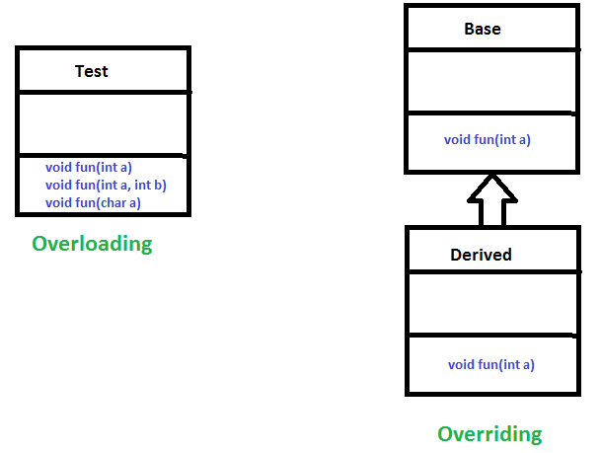

Slide 29
Inheritance and Constructors in Java
A subclass inherits all the members (fields, methods which are not private) from its superclass. Constructors are not members, so they are not inherited by subclasses, but the constructor of the superclass can be invoked from the subclass.
In Java, constructor of base class with no argument gets automatically called in derived class constructor.

Slide 30
class Base {
Base() {
System.out.println("Base Constructor Called ");
}
}
class Derived extends Base {
Derived() {
System.out.println("Derived Constructor Called ");
}
}
public class Main {
public static void main(String[] args) {
Derived d = new Derived();
}}

Slide 31
But, if we want to call parameterized constructor of base class, then we can call it using super().
If the base class has only the parameterized constructor, then we have to define a parameterized constructor in sub class also.

Slide 32
class Base {
int x;
Base(int x) {
this.x = x;
}
}
class Derived extends Base {
int y;
Derived(int x, int y) {
super(x); // calling of super class constructor explicitly
this.y = y;
}
void Display() {
System.out.println("x = "+x+", y = "+y);
}
}
public class Main {
public static void main(String[] args) {
Derived d = new Derived(10, 20);
d.Display();
}
}

